Slide 1
Machine Learning basics

Slide 2

Machine Learning
It is a method that builds analytical model from data automatically.
It is based on the idea that systems can learn from data, identify patterns and make decisions with minimal human intervention.
Model Training algorithm
Model
Data
Output y
Input x

Slide 3
Different Types of Machine Learning
Unsupervised Learning |  | Supervised Learning |  | Reinforcement Learning
Clustering | Consumer segmentation | Classification | Fraud detection | Real-time decisions
 |  |  |  | Game AI
 | Recommendation System |  | Image classification
 |  |  |  | Robot Navigation
 | Recommendation System
 |  | Regression | Price prediction
 |  |  |  | Skill acquisition
 |  |  | Weather forecast
Notes:
There are different types of machine learning and different algorithms for different applications.

Slide 4
Supervised Learning
To learn a function that maps an input to an output based on a training data set that gives examples of input + label (which is the correct output) pairs
Goal: From the training data set build a model that gives good prediction on the labels for the inputs in the dataset.
Then, we can use this model to predict the outcome (i.e., the labels) of out-of-sample data.
Note: A model isn't necessarily a computer program, but rather, it's any mechanism that allows for a definite prediction given any input instance.
Notes:
There’re different types of ML. categorized by the input and the output.
Supervised learning is like the kids learn from the flash cards that this is an apple, orange, banana and then when mom brings the kid to the supermarket, the kid is able to identify that this is an apple, that is an orange, etc. although those apples/oranges in the supermarket are not the same as the one on the flash cards. So the flash cards act as training data while those in the supermarket are out-of-sample data.
In Supervised learning, the input is a labelled dataset, e.g. 1000 items, with different colors and shapes, each labelled as apple/pear,
the ML program learns the function or the rules from the labelled dataset, e.g. what colors classify apples, what shapes classify pears, etc. and then use those the learned rules to predict the outcome of out-of-sample data.

Slide 5
Supervised Learning: Classification
Every input x is associated with a label y where y is from some categorical data, i.e., data whose values can be divided into (a small number) of groups.
An example
Item | Color | Shape | Label
Training data
1 |  | small round | Apple
2 |  | big oval | Pear
3 |  | small round | Apple
4 |  | big round | Apple
: | : | : | :
Notes:
There’re different types of ML. categorized by the input and the output.
Supervised learning is like the kids learn from the flash cards that this is an apple, orange, banana and then when mom brings the kid to the supermarket, the kid is able to identify that this is an apple, that is an orange, etc. although those apples/oranges in the supermarket are not the same as the one on the flash cards. So the flash cards act as training data while those in the supermarket are out-of-sample data.
In Supervised learning, the input is a labelled dataset, e.g. 1000 items, with different colors and shapes, each labelled as apple/pear,
the ML program learns the function or the rules from the labelled dataset, e.g. what colors classify apples, what shapes classify pears, etc. and then use those the learned rules to predict the outcome of out-of-sample data.

Slide 6
Supervised Learning: Classification
Every input x is associated with a label y where y is from some categorical data, i.e., data whose values can be divided into (a small number) of groups.
We need to build a model from some training data for predicting the correct label of any given input.
An example
Item | Color | Shape | Label
Training data
1 |  | small round | Apple
2 |  | big oval | Pear
3 |  | small round | Apple
4 |  | big round | Apple
: | : | : | :
New data
 |  | big oval | ?
Notes:
There’re different types of ML. categorized by the input and the output.
Supervised learning is like the kids learn from the flash cards that this is an apple, orange, banana and then when mom brings the kid to the supermarket, the kid is able to identify that this is an apple, that is an orange, etc. although those apples/oranges in the supermarket are not the same as the one on the flash cards. So the flash cards act as training data while those in the supermarket are out-of-sample data.
In Supervised learning, the input is a labelled dataset, e.g. 1000 items, with different colors and shapes, each labelled as apple/pear,
the ML program learns the function or the rules from the labelled dataset, e.g. what colors classify apples, what shapes classify pears, etc. and then use those the learned rules to predict the outcome of out-of-sample data.

Slide 7
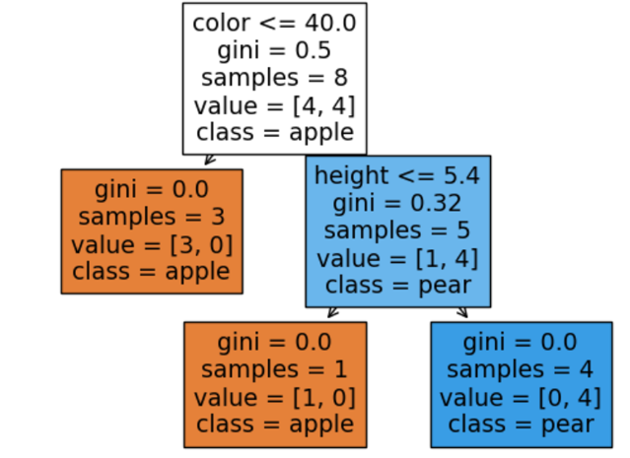
Supervised Learning: Classification
An example
Item | Color | Shape | Label
Training data
1 |  | small round | Apple
2 |  | big oval | Pear
3 |  | small round | Apple
4 |  | big round | Apple
: | : | : | :
New data
 |  | big oval | ?
The model: Decision Tree model
Notes:
There’re different types of ML. categorized by the input and the output.
Supervised learning is like the kids learn from the flash cards that this is an apple, orange, banana and then when mom brings the kid to the supermarket, the kid is able to identify that this is an apple, that is an orange, etc. although those apples/oranges in the supermarket are not the same as the one on the flash cards. So the flash cards act as training data while those in the supermarket are out-of-sample data.
In Supervised learning, the input is a labelled dataset, e.g. 1000 items, with different colors and shapes, each labelled as apple/pear,
the ML program learns the function or the rules from the labelled dataset, e.g. what colors classify apples, what shapes classify pears, etc. and then use those the learned rules to predict the outcome of out-of-sample data.

Slide 8
Supervised learning: Regression
Every input x is associated with a label y, where y is some numerical value (or some higher dimension numerical vector)
An example
Temperature (°C) x | Ice-cream Sales (No. of cones) y
Training data
10 | 4
12 | 5
16 | 7
20 | 10
…
Notes:
Another type of supervised learning problem is like this, let’s say we have recorded the temperature and the ice-cream sales in the past few days, then given the weather forecast saying tomorrow’s temperature is going to be 30°C, we want to predict the ice-cream sales so that we will know how many cones to prepare.
This is an example of regression problem, temperature is the predictor and we want to predict the no. of cones which is a value.
Here, we plotted the temperature and ice-cream sales on a graph shown as the blue dots, regression is to find a line that best fit the data points, and then we from the line we can predict if tomorrow’s temperature is 30°C, 18 cones will be sold. In this example, the prediction follows a straight line, this is simple linear regression.
In some cases, a straight line may not fit, then this is a polynomial linear regression.
When there are multiple predictors, then that is a multiple linear regression.

Slide 9
Supervised learning: Regression
Every input x is associated with a label y, where y is some numerical value (or some higher dimension numerical vector)
We need to build a model from some training data for predicting the correct label of any given input.
An example
Temperature (°C) x | Ice-cream Sales (No. of cones) y
Training data
10 | 4
12 | 5
16 | 7
20 | 10
new data
30 | ?
Notes:
Another type of supervised learning problem is like this, let’s say we have recorded the temperature and the ice-cream sales in the past few days, then given the weather forecast saying tomorrow’s temperature is going to be 30°C, we want to predict the ice-cream sales so that we will know how many cones to prepare.
This is an example of regression problem, temperature is the predictor and we want to predict the no. of cones which is a value.
Here, we plotted the temperature and ice-cream sales on a graph shown as the blue dots, regression is to find a line that best fit the data points, and then we from the line we can predict if tomorrow’s temperature is 30°C, 18 cones will be sold. In this example, the prediction follows a straight line, this is simple linear regression.
In some cases, a straight line may not fit, then this is a polynomial linear regression.
When there are multiple predictors, then that is a multiple linear regression.

Slide 10
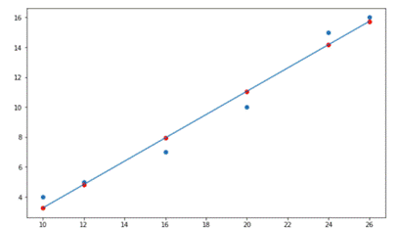
Supervised learning: Regression
Regression refers to the general statistical method for determining the relationship between input x and output y, where x and y can be high-dimensional vectors.
Example: Find a linear relationship between x and y where x, y are just single real numbers.
An example
Temperature (°C) x | Ice-cream Sales (No. of cones) y
Training data
10 | 4
12 | 5
16 | 7
20 | 10
new data
30 | ?
The model: Linear Regression
30
Notes:
Another type of supervised learning problem is like this, let’s say we have recorded the temperature and the ice-cream sales in the past few days, then given the weather forecast saying tomorrow’s temperature is going to be 30°C, we want to predict the ice-cream sales so that we will know how many cones to prepare.
This is an example of regression problem, temperature is the predictor and we want to predict the no. of cones which is a value.
Here, we plotted the temperature and ice-cream sales on a graph shown as the blue dots, regression is to find a line that best fit the data points, and then we from the line we can predict if tomorrow’s temperature is 30°C, 18 cones will be sold. In this example, the prediction follows a straight line, this is simple linear regression.
In some cases, a straight line may not fit, then this is a polynomial linear regression.
When there are multiple predictors, then that is a multiple linear regression.

Slide 11
Unsupervised Learning: Clustering
To train and construct a model from which we can determine a natural grouping in data
User | Rating of Movie A | Rating of Movie B
1 | 1 | 2
2 | 7 | 4
3 | 2 | 3
4 | 6 | 8
5 | 4 | 8
6 | 8 | 4
7 | 9 | 5
8 | 3 | 1
9 | 4 | 9
Notes:
Let’s take a look at this problem.
Let’s say here we have the movie ratings from 10 users, would you recommend movie B to user 10? Will user 10 like movie B?
This is a clustering problem, we want the computer to discover the natural grouping in data, then we know user 10 shall belong to the red group which like movie B a lot.

Slide 12
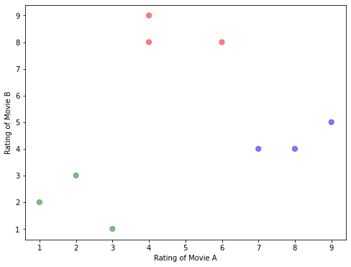
Unsupervised Learning: Clustering
User | Rating of Movie A | Rating of Movie B
1 | 1 | 2
2 | 7 | 4
3 | 2 | 3
4 | 6 | 8
5 | 4 | 8
6 | 8 | 4
7 | 9 | 5
8 | 3 | 1
9 | 4 | 9
The model: Partition the points into groups
Notes:
Let’s take a look at this problem.
Let’s say here we have the movie ratings from 10 users, would you recommend movie B to user 10? Will user 10 like movie B?
This is a clustering problem, we want the computer to discover the natural grouping in data, then we know user 10 shall belong to the red group which like movie B a lot.

Slide 13
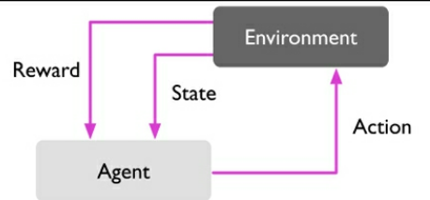
Reinforcement Learning
Reinforcement learning is learning what to do – how to map situations to actions – so as to maximize a numerical reward signal. The learner (agent) is not told which actions to take; instead, it must discover which actions yield the most reward by trying them.

Slide 14
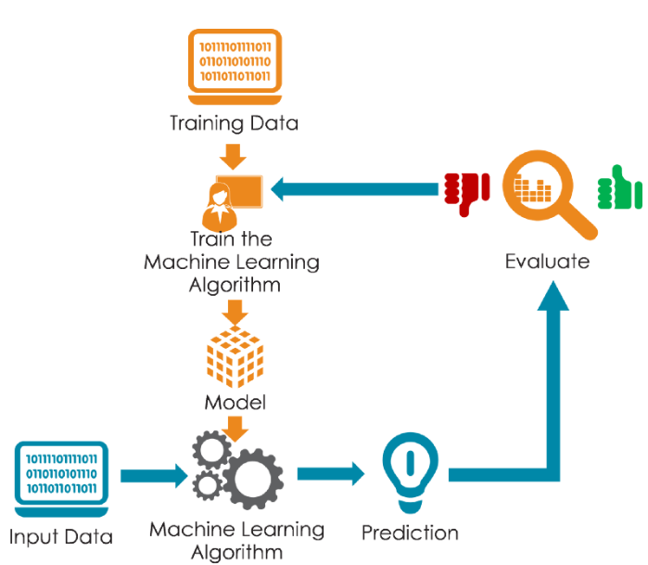


How to do Machine Learning? 7 steps of Machine Learning
Gathering data
Data preparation
(Hyper)parameter tuning
Choosing a ML algorithm
Training the model
Evaluation
Validation Data
Predicting unseen data
Testing/Unseen Data
Notes:
So, how to do ML? The basic premise of machine learning is to build algorithms that can receive data and use statistical analysis to predict an output while updating outputs as new data becomes available.
There’re 7 steps to do in ML:
& 2. we need to gather and prepare the training data
3. Choose for a ML algorithm, there are different types of ML as we just introduced, and for each type of ML, there’re different ML algorithms
4. Fit the training data to the ML algorithm to train a model, i.e. using the algorithm to learn the set of rules form the training data
5. Fit validation data to the model and evaluate whether the prediction from the model is accurate or not
6. With the evaluation, we may need to adjust the parameters of the ML algorithm and train another model and evaluate again to come up with a good model to use
7. We can use the model to predict unseen data

Slide 15
How to do Machine Learning? 7 steps of Machine Learning
Gathering data
Data preparation
(Hyper)parameter tuning
Choosing a ML algorithm
Training the model
Evaluation
Validation Data
Predicting unseen data
Testing/Unseen Data
Notes:
So, how to do ML? The basic premise of machine learning is to build algorithms that can receive data and use statistical analysis to predict an output while updating outputs as new data becomes available.
There’re 7 steps to do in ML:
& 2. we need to gather and prepare the training data
3. Choose for a ML algorithm, there are different types of ML as we just introduced, and for each type of ML, there’re different ML algorithms
4. Fit the training data to the ML algorithm to train a model, i.e. using the algorithm to learn the set of rules form the training data
5. Fit validation data to the model and evaluate whether the prediction from the model is accurate or not
6. With the evaluation, we may need to adjust the parameters of the ML algorithm and train another model and evaluate again to come up with a good model to use
7. We can use the model to predict unseen data

Slide 16
How to do Machine Learning? 7 steps of Machine Learning
Handling missing values and outliers
Feature scaling
Feature selection
Feature extraction: dimensionality reduction
Gathering data
Data preparation
(Hyper)parameter tuning
Choosing a ML algorithm
Training the model
Evaluation
Validation Data
Predicting unseen data
Testing/Unseen Data
Notes:
So, how to do ML? The basic premise of machine learning is to build algorithms that can receive data and use statistical analysis to predict an output while updating outputs as new data becomes available.
There’re 7 steps to do in ML:
& 2. we need to gather and prepare the training data
3. Choose for a ML algorithm, there are different types of ML as we just introduced, and for each type of ML, there’re different ML algorithms
4. Fit the training data to the ML algorithm to train a model, i.e. using the algorithm to learn the set of rules form the training data
5. Fit validation data to the model and evaluate whether the prediction from the model is accurate or not
6. With the evaluation, we may need to adjust the parameters of the ML algorithm and train another model and evaluate again to come up with a good model to use
7. We can use the model to predict unseen data

Slide 17
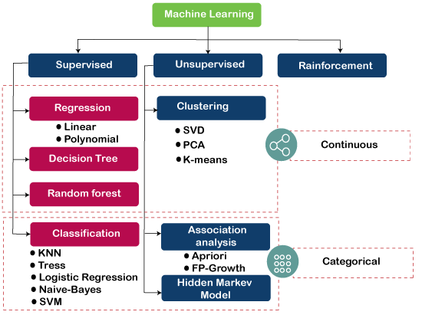
How to do Machine Learning? 7 steps of Machine Learning
Gathering data
Data preparation
(Hyper)parameter tuning
Choosing a ML algorithm
Training the model
Evaluation
Validation Data
Predicting unseen data
Testing/Unseen Data
Notes:
So, how to do ML? The basic premise of machine learning is to build algorithms that can receive data and use statistical analysis to predict an output while updating outputs as new data becomes available.
There’re 7 steps to do in ML:
& 2. we need to gather and prepare the training data
3. Choose for a ML algorithm, there are different types of ML as we just introduced, and for each type of ML, there’re different ML algorithms
4. Fit the training data to the ML algorithm to train a model, i.e. using the algorithm to learn the set of rules form the training data
5. Fit validation data to the model and evaluate whether the prediction from the model is accurate or not
6. With the evaluation, we may need to adjust the parameters of the ML algorithm and train another model and evaluate again to come up with a good model to use
7. We can use the model to predict unseen data

Slide 18
How to do Machine Learning? 7 steps of Machine Learning
Gathering data
Data preparation
(Hyper)parameter tuning
Choosing a ML algorithm
Training the model
Evaluation
Validation Data
Predicting unseen data
Testing/Unseen Data
Notes:
So, how to do ML? The basic premise of machine learning is to build algorithms that can receive data and use statistical analysis to predict an output while updating outputs as new data becomes available.
There’re 7 steps to do in ML:
& 2. we need to gather and prepare the training data
3. Choose for a ML algorithm, there are different types of ML as we just introduced, and for each type of ML, there’re different ML algorithms
4. Fit the training data to the ML algorithm to train a model, i.e. using the algorithm to learn the set of rules form the training data
5. Fit validation data to the model and evaluate whether the prediction from the model is accurate or not
6. With the evaluation, we may need to adjust the parameters of the ML algorithm and train another model and evaluate again to come up with a good model to use
7. We can use the model to predict unseen data

Slide 19
How to do Machine Learning? 7 steps of Machine Learning
Gathering data
Data preparation
(Hyper)parameter tuning
Performance metrics: accuracy, recall, precision, ROC, RMSE
Cross-Validation
Choosing a ML algorithm
Training the model
Evaluation
Validation Data
Predicting unseen data
Testing/Unseen Data
Notes:
So, how to do ML? The basic premise of machine learning is to build algorithms that can receive data and use statistical analysis to predict an output while updating outputs as new data becomes available.
There’re 7 steps to do in ML:
& 2. we need to gather and prepare the training data
3. Choose for a ML algorithm, there are different types of ML as we just introduced, and for each type of ML, there’re different ML algorithms
4. Fit the training data to the ML algorithm to train a model, i.e. using the algorithm to learn the set of rules form the training data
5. Fit validation data to the model and evaluate whether the prediction from the model is accurate or not
6. With the evaluation, we may need to adjust the parameters of the ML algorithm and train another model and evaluate again to come up with a good model to use
7. We can use the model to predict unseen data

Slide 20
How to do Machine Learning? 7 steps of Machine Learning
Hyperparameter Optimization: Grid-Search
Gathering data
Data preparation
(Hyper)parameter tuning
Choosing a ML algorithm
Training the model
Evaluation
Validation Data
Predicting unseen data
Testing/Unseen Data
Notes:
So, how to do ML? The basic premise of machine learning is to build algorithms that can receive data and use statistical analysis to predict an output while updating outputs as new data becomes available.
There’re 7 steps to do in ML:
& 2. we need to gather and prepare the training data
3. Choose for a ML algorithm, there are different types of ML as we just introduced, and for each type of ML, there’re different ML algorithms
4. Fit the training data to the ML algorithm to train a model, i.e. using the algorithm to learn the set of rules form the training data
5. Fit validation data to the model and evaluate whether the prediction from the model is accurate or not
6. With the evaluation, we may need to adjust the parameters of the ML algorithm and train another model and evaluate again to come up with a good model to use
7. We can use the model to predict unseen data

Slide 21
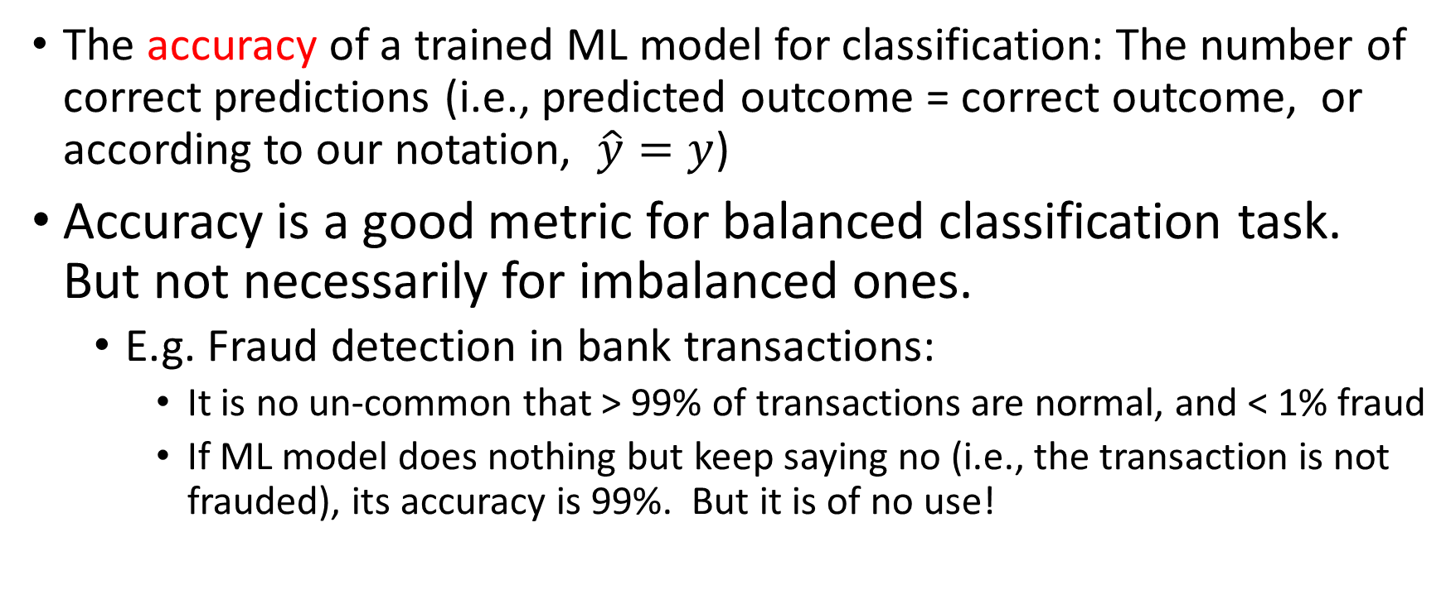
Performance measurement for classification
The accuracy of a trained ML model for classification: The number of correct predictions (i.e., predicted outcome = correct outcome, or according to our notation, $\hat{y}=y$)
Accuracy is a good metric for balanced classification task. But not necessarily for imbalanced ones.
E.g. Fraud detection in bank transactions:
It is no un-common that > 99% of transactions are normal, and < 1% fraud
If ML model does nothing but keep saying no (i.e., the transaction is not frauded), its accuracy is 99%. But it is of no use!

Slide 22
Better measure (for binary classification)
Binary classification
Given any input, the ML algorithm predicts Positive / Negative.
E.g., Positive if the transaction is frauded; Negative it is not frauded.
There are four possibilities
True Positive: actual is positive, and ML predicts a positive.
True Negative: actual is negative, and ML predicts a negative.
False Negative: actual is positive, but ML predicts a negative.
False Positive: actual is negative, but the test predicts a positive.

Slide 23
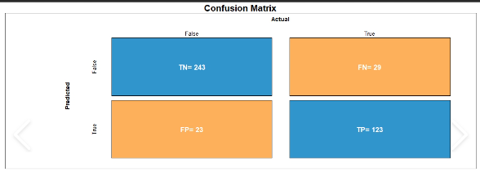
Confusion matrix
An example (which can be constructed by the confusion_matrix(y_actual, y_pred) method from sklearn)
negative
positive
negative
positive

Slide 24
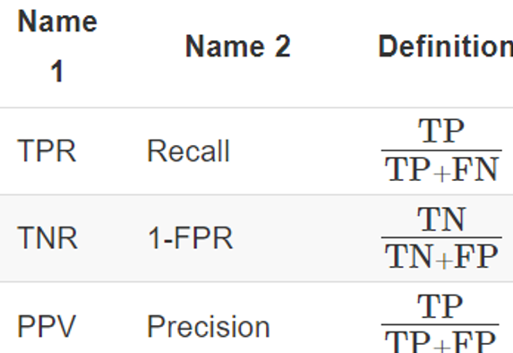
Performance measures for binary classification

Slide 25
Performance measures for binary classification
True positive rate: measures the % of positive instances
that ML can detect.

Slide 26
Performance measures for binary classification
True positive rate: measures the % of positive instances
that ML can detect.
True negative rate: measures the % of negative instances
that ML can detect.
Positive predictive values: measures the % of correct instances
that ML reports positive

Slide 27
Performance measures for binary classification
Other names you may find in the
literature.

Slide 28
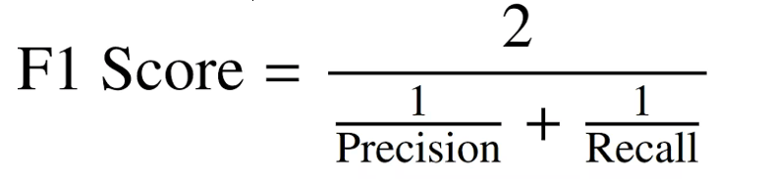
F1-score: Another measure for binary classification
Combine recall and precision
Definition
To have a good (high) F1-score, both recall
and precision have to
be good.

Slide 29
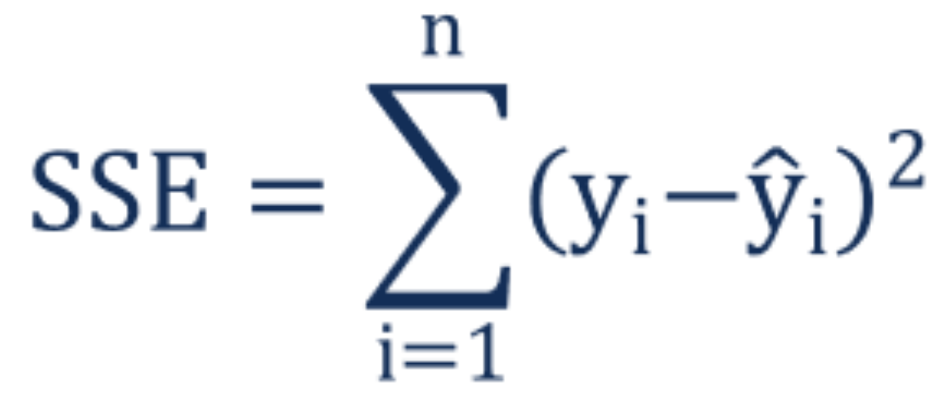
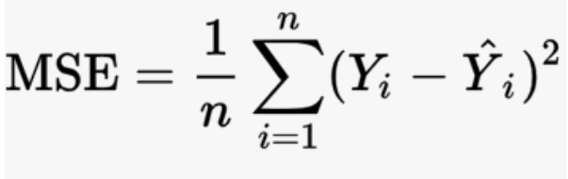
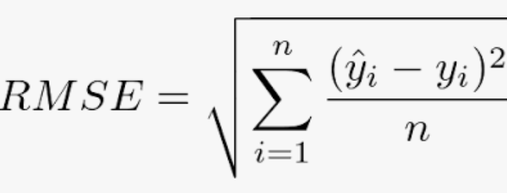
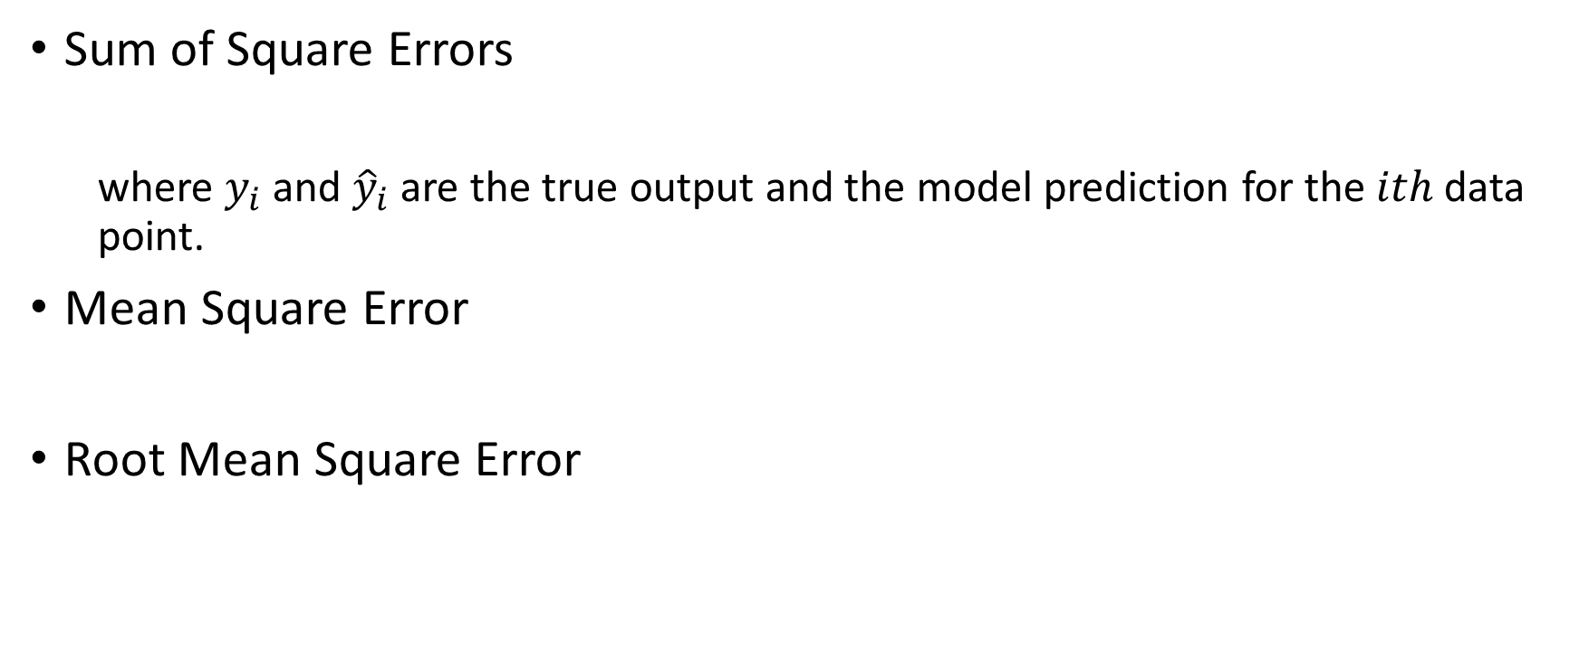
Performance measure of regression
Sum of Square Errors
where $y_{i}$ and ${\hat{y}}_{i}$ are the true output and the model prediction for the $ith$ data point.
Mean Square Error
Root Mean Square Error

Slide 30
Software libraries for ML

Slide 31

Traditional ML methods: scikit-learn
Scikit-learn (also known as sklearn) is a free software library for Python. It includes various numerous machine learning algorithms for classification, regression and clustering.
It was initially developed as a Google summer of code project in 2007. Later, the French institute INRIA got involved and the first public release was published in 2010.

Slide 32
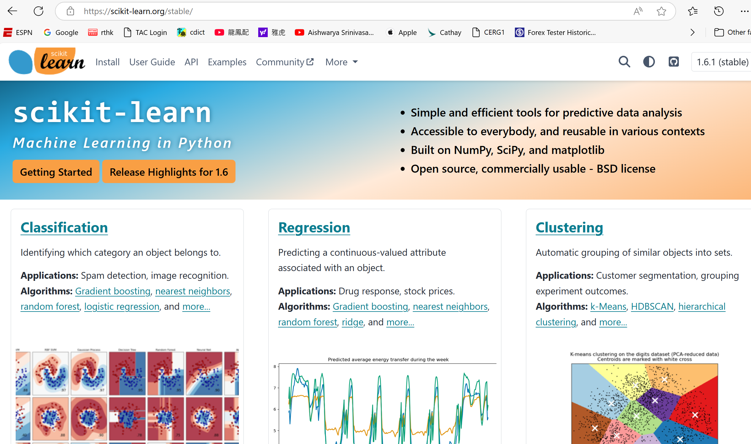

Slide 33

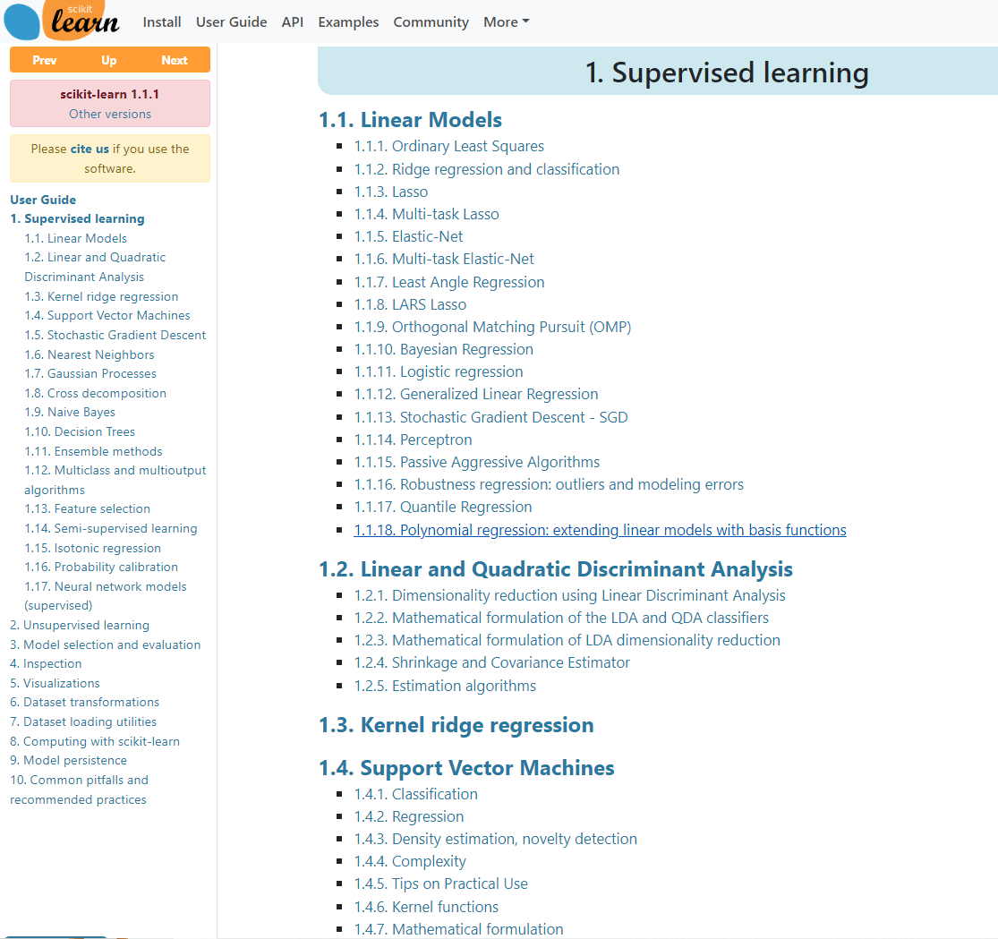
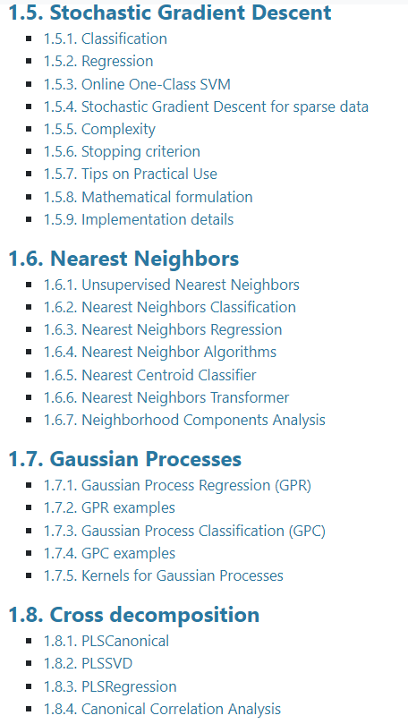
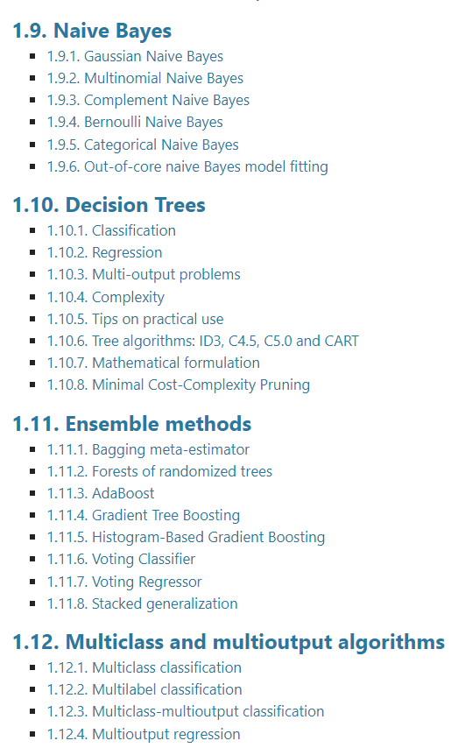
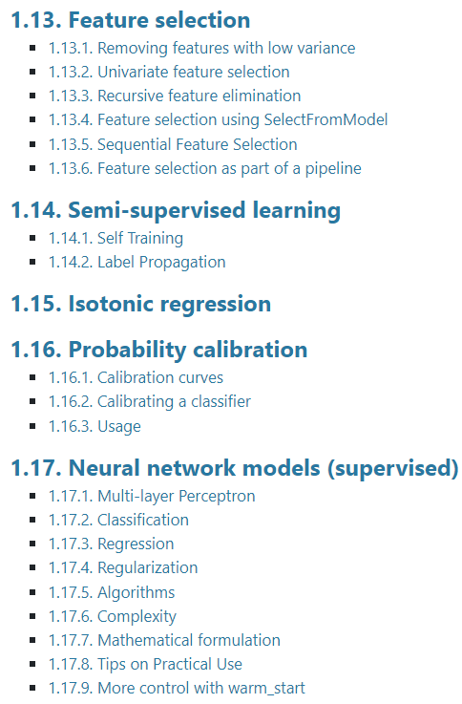

Slide 34
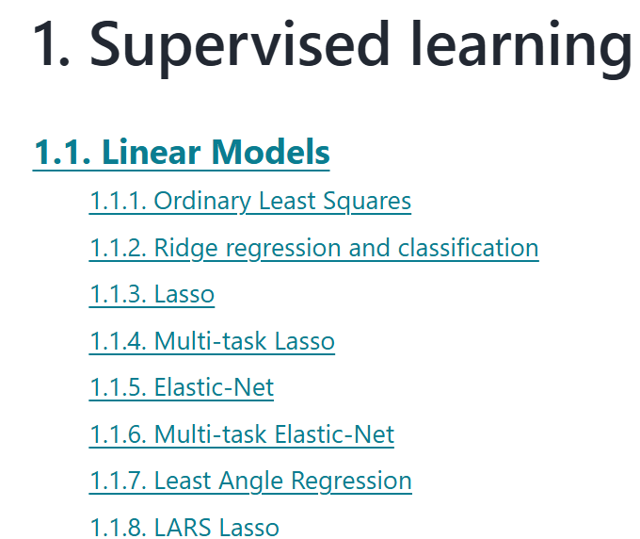
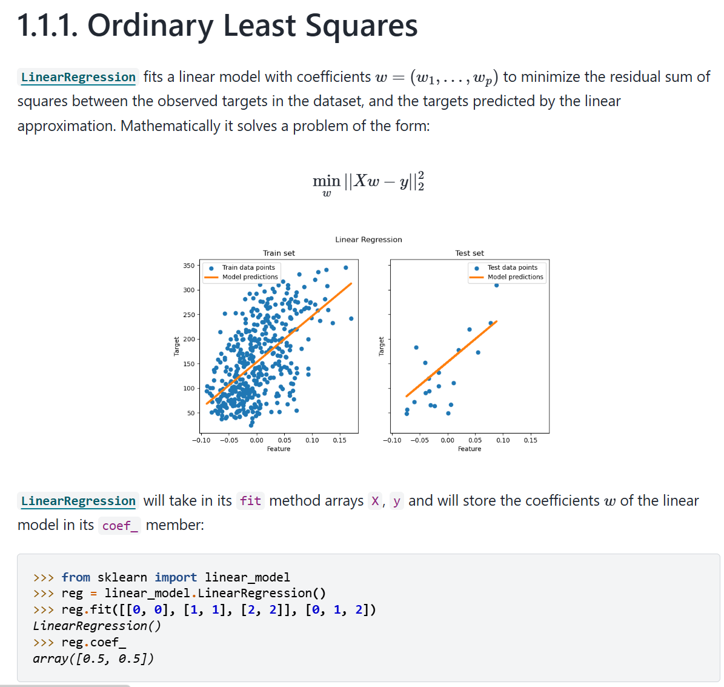

Slide 35
Some examples

Slide 36
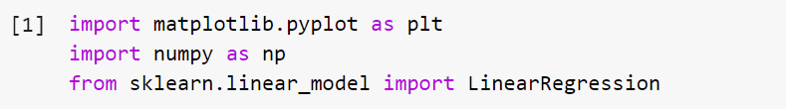
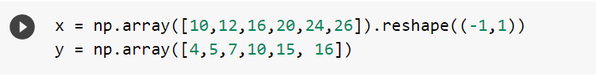
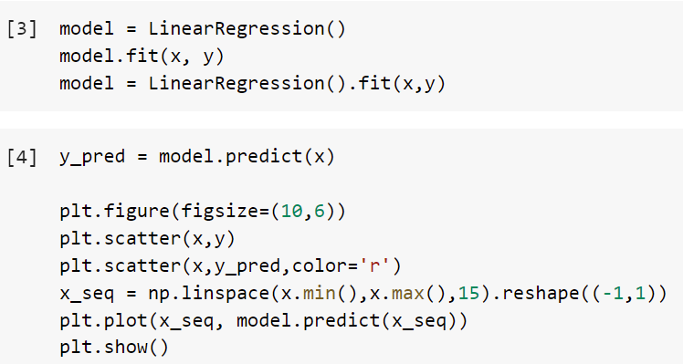
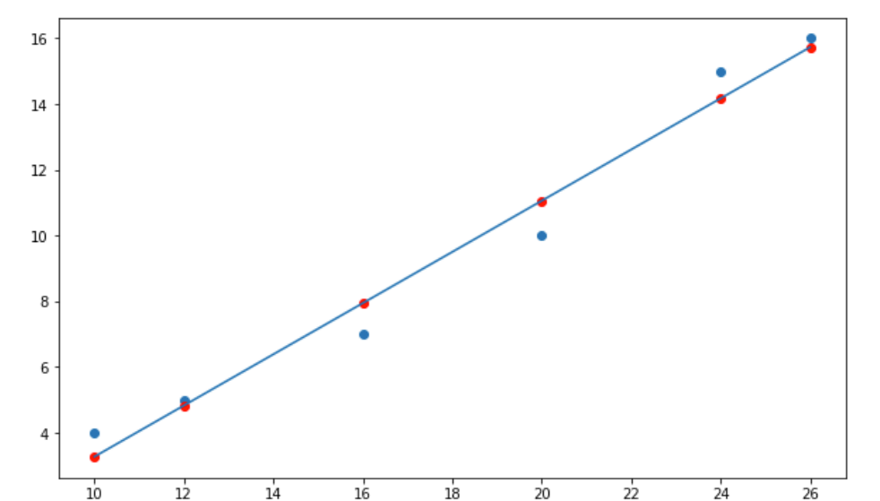
Supervised learning: Linear Regression model for predicting ice cream sales
Temperature (°C) x | Ice-cream Sales (No. of cones) y
10 | 4
12 | 5
16 | 7
20 | 10
24 | 15
30 | ?

Slide 37
Supervised learning: Linear Regression model for predicting ice cream sales
Temperature (°C) x | Ice-cream Sales (No. of cones) y
10 | 4
12 | 5
16 | 7
20 | 10
24 | 15
30 | ?
Why reshape() here?

Slide 38
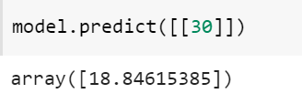
Supervised learning: Linear Regression model for predicting ice cream sales
Temperature (°C) x | Ice-cream Sales (No. of cones) y
10 | 4
12 | 5
16 | 7
20 | 10
24 | 15
30 | ?

Slide 39
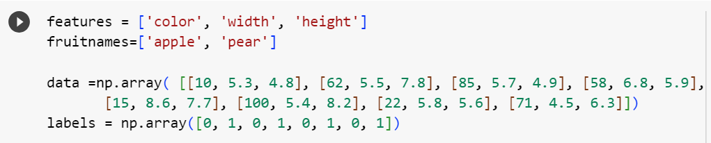
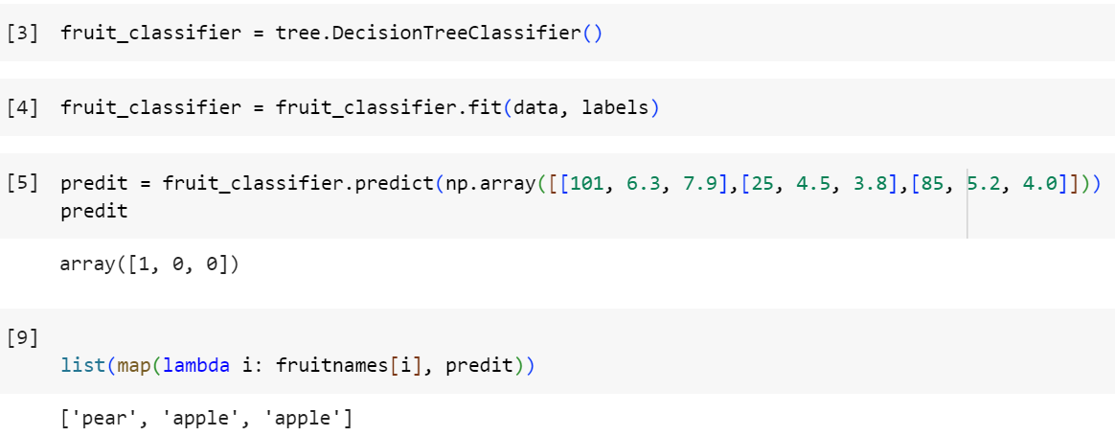
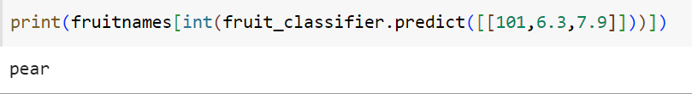
Supervised learning: Classifying Apple vs Pear

Slide 40
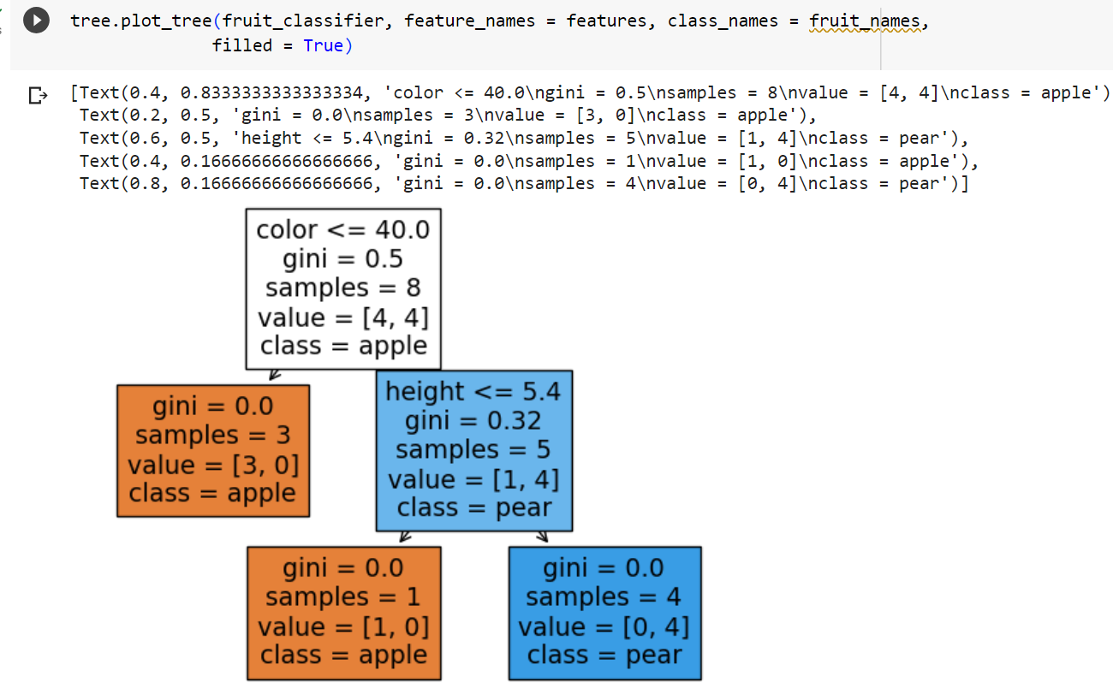
Supervised learning: Classifying Apple vs Pear

Slide 41
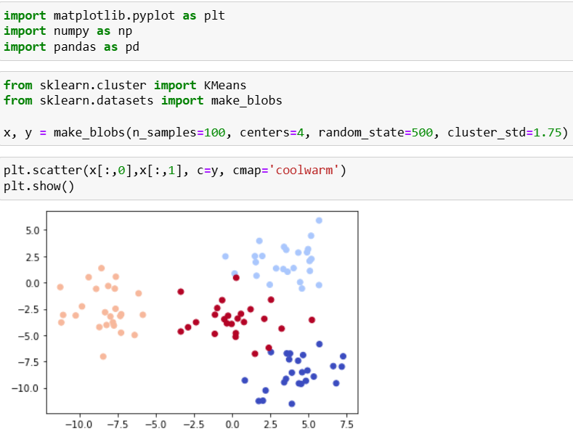
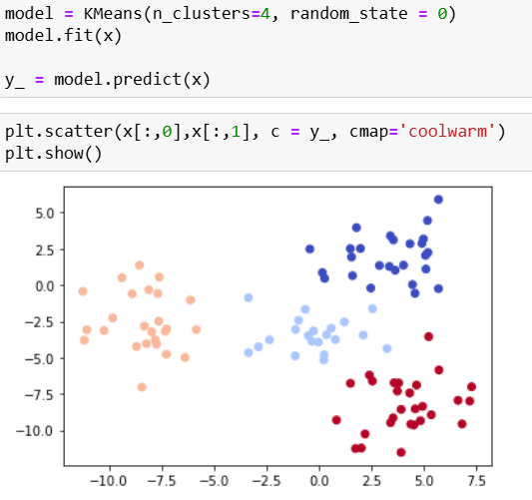
Unsupervised learning: clustering points on 2D plane

Slide 42
Artificial neural network and deep learning

Slide 43
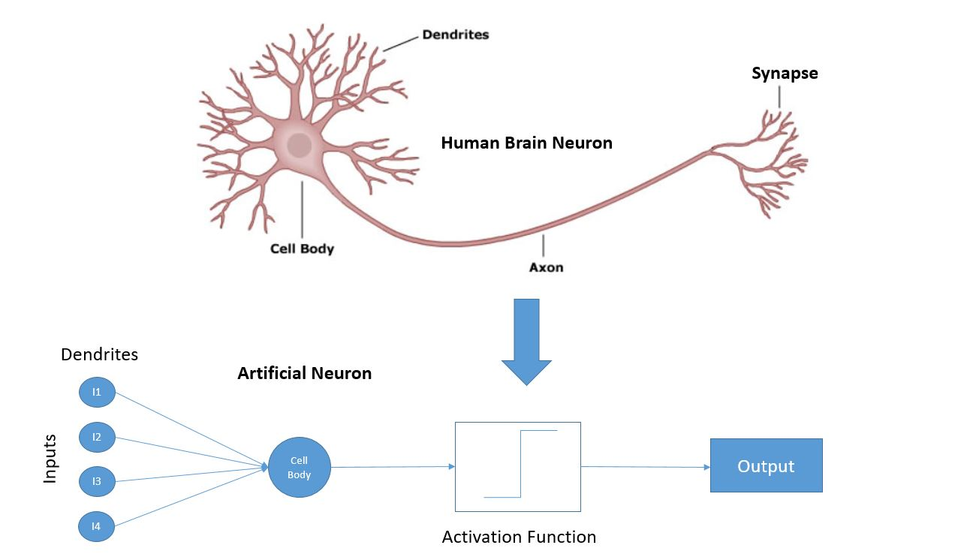
A neuron
An
artificial
neuron

Slide 44
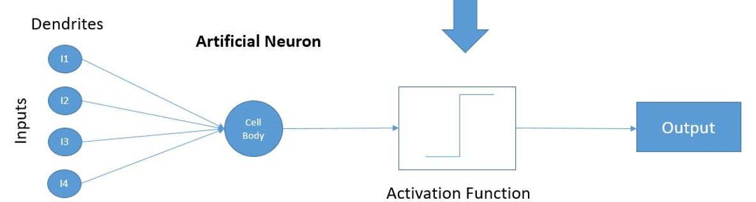
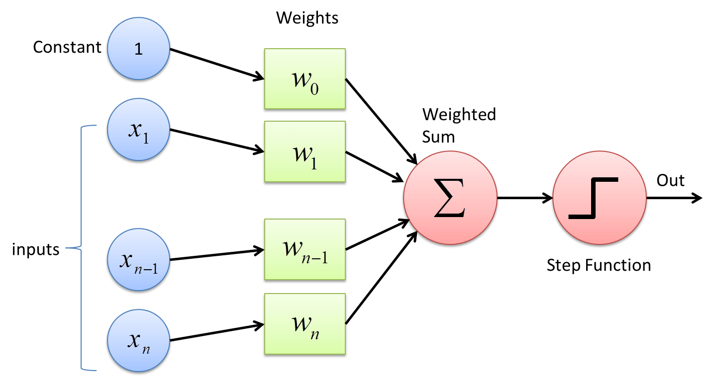
Perceptron:
Final model for an
artificial neuron

Slide 45
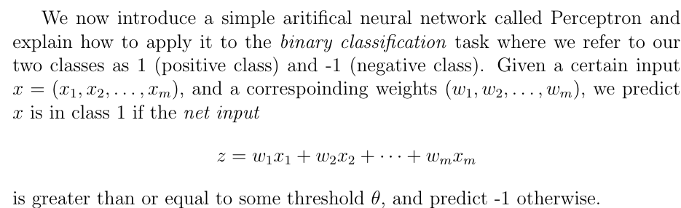
The Perceptron

Slide 46
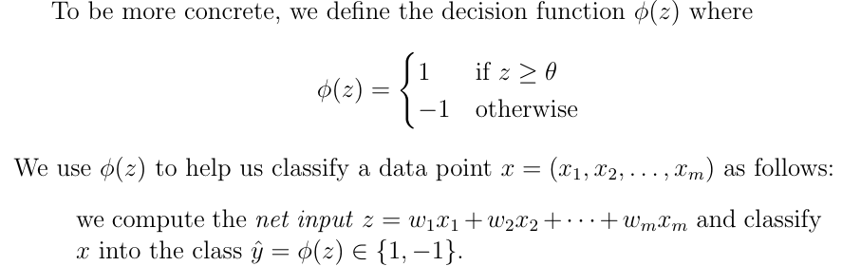
The Perceptron

Slide 47
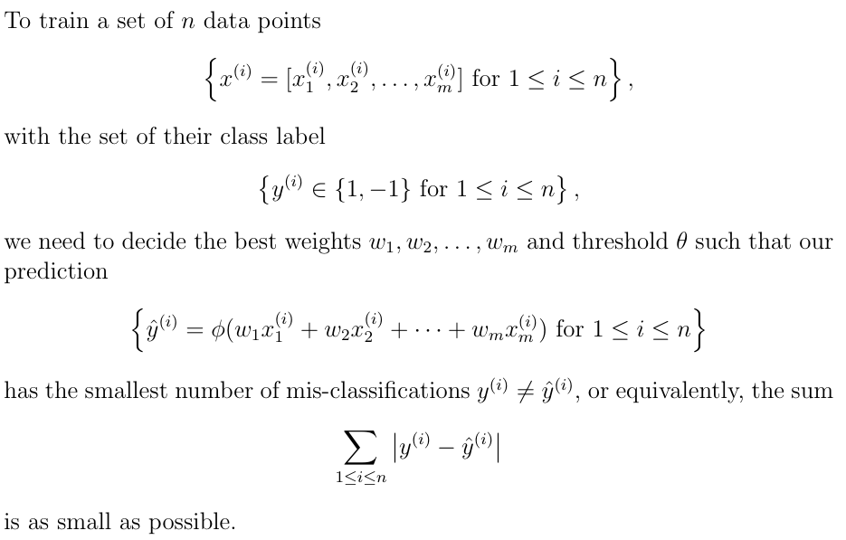

Slide 48
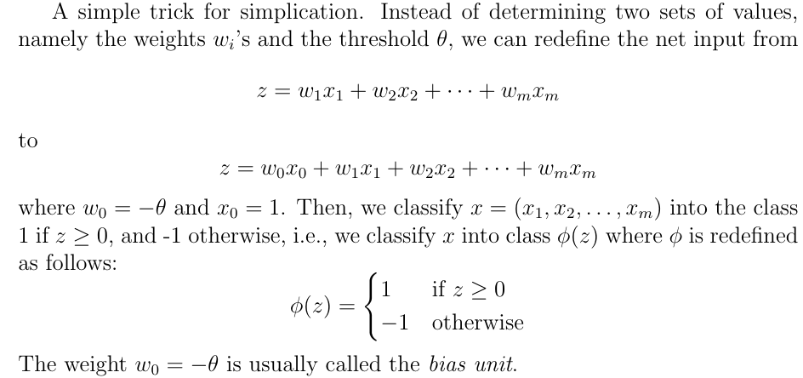
The Perceptron

Slide 49
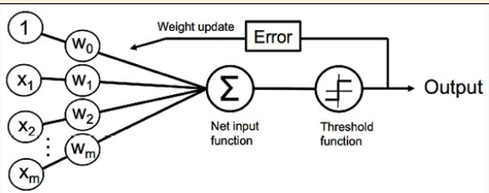
How to train a perceptron?

Slide 50
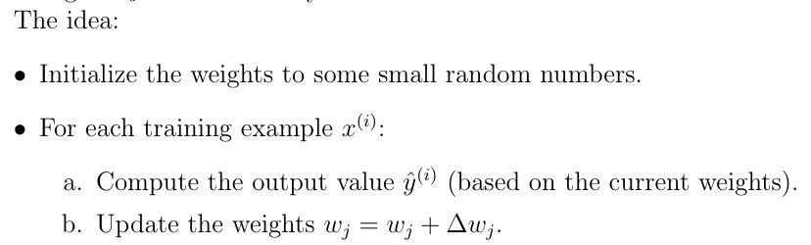
How to train a perceptron?

Slide 51
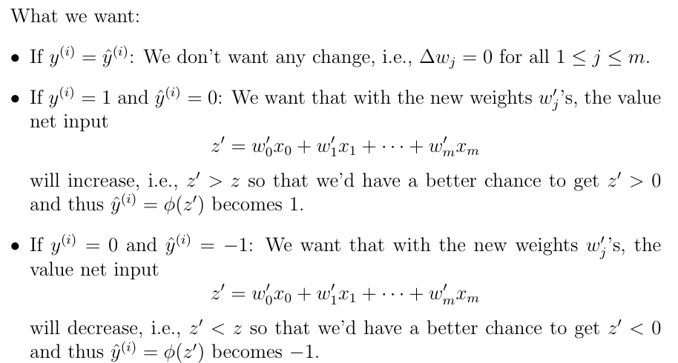
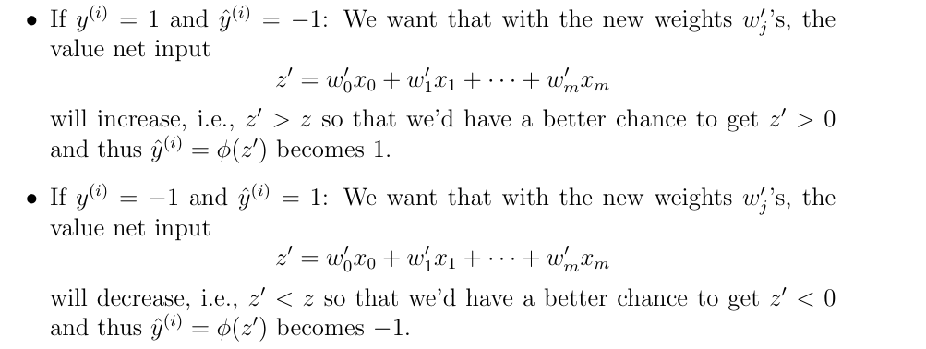
How to train a perceptron?

Slide 52
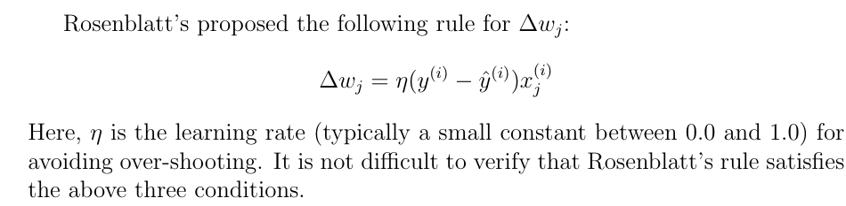
How to train a perceptron?

Slide 53
How to train a perceptron?
A very important hyper-parameter,
especially for a training data set
with million of examples.

Slide 54
Deep learning: TensorFlow and Keras
TensorFlow is a free software library for machine learning and AI. It can be used across a range of tasks but focuses on training and inference of deep neural networks.
TensorFlow was developed by the Google Brain team.
Keras is a free software library that provides a Python interface for neural network. It is commonly used as an interface for the TensorFlow library.

Slide 55

Why not Pytorch?

Slide 56

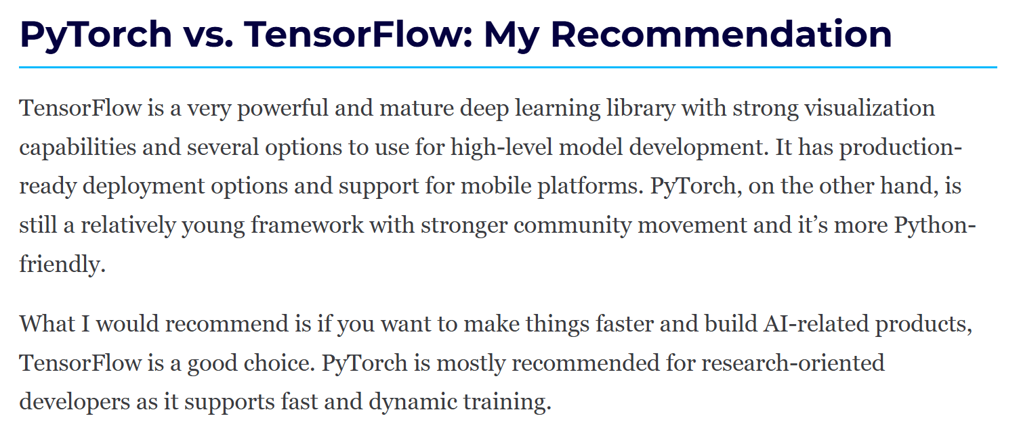
Why not Pytorch?

Slide 57
Example: classifying digits

Slide 58
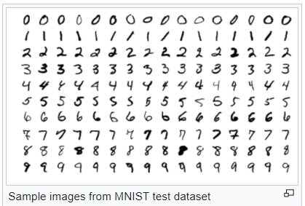
Deep Learning: Train a neural network for digit classification
The MNIST (Modified National Institute of Standards and Technology) dataset for training.
It is a large dataset of handwritten digits created in 1998.
Over the years, researchers used this dataset to test the accuracy of different ML methods.

Slide 59
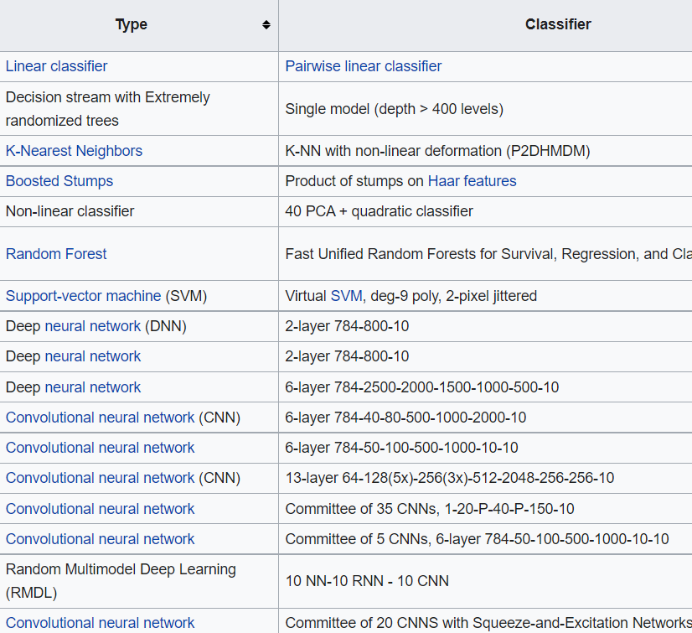
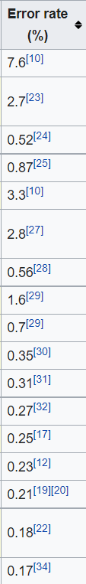

Slide 60
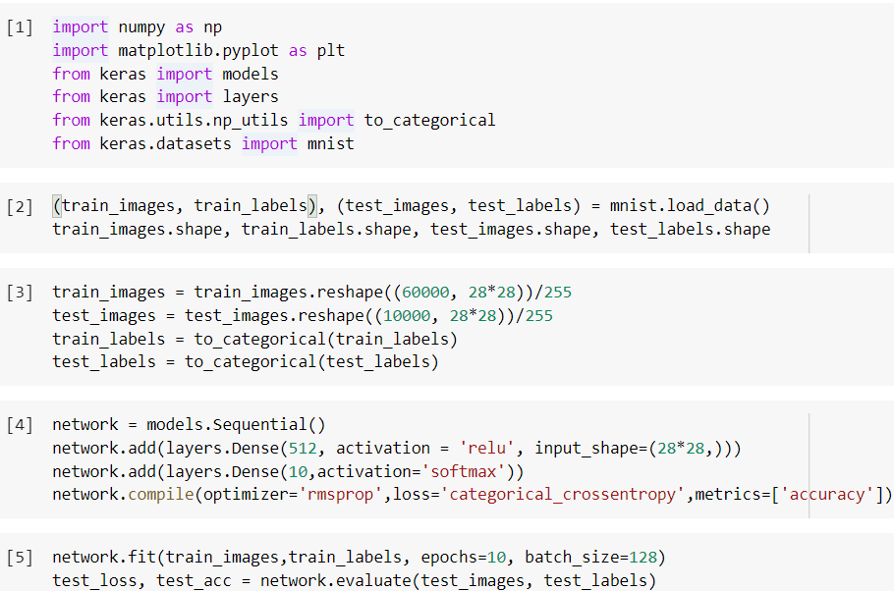
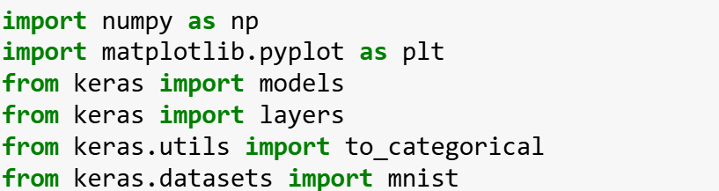
Deep Learning: Train a neural network for digit classification

Slide 61

Deep Learning: Train a neural network for digit classification

Slide 62
Deep Learning: Train a neural network for digit classification

Slide 63
Deep Learning: Train a neural network for digit classification

Slide 64

Deep Learning: Train a neural network for digit classification

Slide 65

Deep Learning: Train a neural network for digit classification

Slide 66
Deep Learning: Train a neural network for digit classification

Slide 67
Deep Learning: Train a neural network for digit classification
softmax function

Slide 68

Deep Learning: Train a neural network for digit classification

Slide 69
Deep Learning: Train a neural network for digit classification
The probability that the input is in class 2.

Slide 70
Deep Learning: Train a neural network for digit classification

Slide 71

Deep Learning: Train a neural network for digit classification
?????
You don’t need to remember it.
All you need to know is the
optimizer will set the weights
appropriately to make CE
as small as possible (over the
training data set).

Slide 72

Deep Learning: Train a neural network for digit classification
The algorithm we choose
to minimize the loss
functions. There are
many choices:

Slide 73
Deep Learning: Train a neural network for digit classification
The algorithm we choose
to minimize the loss
functions. There are
many choices:
Behaviour of different optimizer: CS231n Convolutional Neural Networks for Visual Recognition

Slide 74
Deep Learning: Train a neural network for digit classification
One epoch is one complete pass of the training dataset
through the algorithm

Slide 75
Deep Learning: Train a neural network for digit classification
The number of data points used for
an update of the weights

Slide 76

Deep Learning: Train a neural network for digit classification
batch_size = 1: Each update is fast,
but the path to the minimum is
not smooth: there are ups and down

Slide 77

Deep Learning: Train a neural network for digit classification
batch_size = 1: Each update is fast,
but the path to the minimum is
not smooth: there are ups and down
batch_size = the size of the whole data
set: Each update is very slow,
but the path to the minimum is
very smooth

Slide 78

Deep Learning: Train a neural network for digit classification
batch_size = 1: Each update is fast,
but the path to the minimum is
not smooth: there are ups and down
batch_size = the size of the whole data
set: Each update is very slow,
but the path to the minimum is
very smooth
batch_size = somewhere between
1 and dataset’s size

